Slide 1
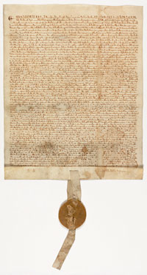
Inspiration for a New Nation
SS.7.C.1.2 Trace the impact that the Magna Carta, English Bill of Rights, Mayflower Compact, and Thomas Paine’s Common Sense had on colonists’ views of government.
Historical Documents and Their Impact on the Founders

Slide 2
Bell Ringer
Imagine you are on a cruise with a group of 20+ friends when all of a sudden the boat is lost in a storm. You finally spot land in the distance and the group makes its way towards it. As you get closer, you quickly realize there is no civilization on the island. Hungry and exhausted, everyone begins to argue. You all decide that rules have to be made for everyone’s protection and benefit.
Brainstorm about what you and your friends would do.
What rules do you think you and your friends would make? Come up with at least 3.
Would you make these rules before or after you arrive onto the island? Why?
Would there be a single leader or group of leaders? How would you choose them? Explain.
Notes:
Ask students where they think the colonists and Founders got their ideas about our government. Discuss responses.

Slide 3


Inspiration for a New Nation
Where did the colonists and the Founding Fathers get their ideas about our government?
Notes:
Ask students where they think the colonists and Founders got their ideas about our government. Discuss responses.

Slide 4

Influential Individuals
Locke
M
Montesquieu
Natural Law
Locke’s social contract
Separation of Power
ocke
The Government
The people
Social
Contract
Executive
Judicial
Legislative

Slide 5
Important Ideas
Rule of Law
All people must follow the laws, and the laws should be enforced fairly and equally.
Self-Government
People can make decisions on how their government should work.
Notes:
Ask students where they think the colonists and Founders got their ideas about our government. Discuss responses.

Slide 6
Important Ideas
Limited Government
A government that has been limited in power by a constitution, or written agreement.
Rights
Guarantees or protections for our freedoms
Social Contract
An agreement among the people to set up a government and obey its laws.
John Locke
Notes:
Ask students where they think the colonists and Founders got their ideas about our government. Discuss responses.

Slide 7
Magna Carta
Written in 1215 in England
Also known as the “Great Charter”
Written by the English nobles (the wealthy princes and dukes of England who were, in theory, loyal to the king) → govt document
Granted certain rights and liberties to English nobles:
Right to a jury and speedy trial
Guarantees against the loss of life, liberty, or property
Was agreed to by King John of England – no one was above the law
"To no one will We sell, to no one will We deny or delay, right or justice.“
National Archives and Records Administration. "Featured Document: The Magna Carta." National Archives and Records Administration. Web. 28 Mar. 2012. <http://www.archives.gov/exhibits/featured_documents/magna_carta/>.
Notes:
Discuss facts about Magna Carta and instruct students to write information about the document in the appropriate section of their foldable note taker.

Slide 8
Magna Carta
This was the first example
of limited government.
Specifically, a limited monarchy
Why is the concept of “limited government” important?
What would a government without limits be like?
Notes:
The main ideas in the Magna Carta are limited government and the Rule of Law.
Discuss why limited government is so important. Try to have students make a connection to Montesquieu and the separation of power and the need to check power.
Rule of Law will be further discussed on the following slide.

Slide 9
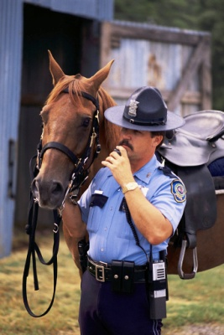


The Magna Carta also addressed the “Rule of Law”
What do you think “Rule of Law” means?
No one – not the King, the President, celebrities, you, the teacher, the principal – is above the law.
Everyone is equal under the law
RULE OF LAW
Notes:
Ask students what they think “rule of law” means. Discuss responses.
The Rule of Law is that no one is above the law and the law applies to everyone. Ask students if they think this is important to outline in a government. If so, why? If not, why not?

Slide 10
Magna Carta
Inspiration for the Nation
Limited Government
Rule of Law + Rights
Notes:
This slide will appear multiple times to outline all of the main ideas from the documents the Founders used in moving towards declaring independence and utilizing in the creation of the new government.

